Slide 1
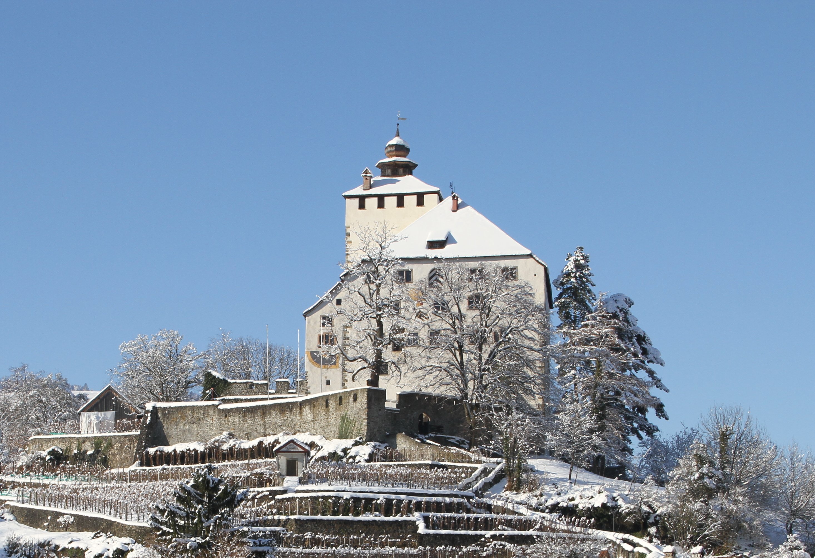
P&I Schema Migration at Roche
Team Werdenberg Castle
Sebastian Minder, Marc Funken, Fabio Eglin, Thomas Nirnberger

Slide 2
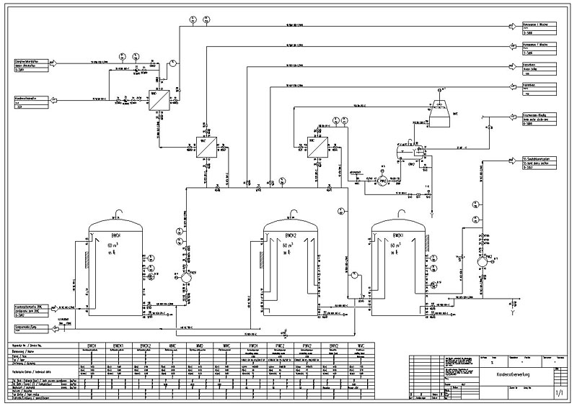
500 process instances per year
12 000 working hours
Project duration: 3 years
> 15 employees involved in workflow
1 process

Slide 3
Agenda
Project introduction
As Is Process
To Be Process
Decision Tables
Automation with Integromat
Process Mining

Slide 4
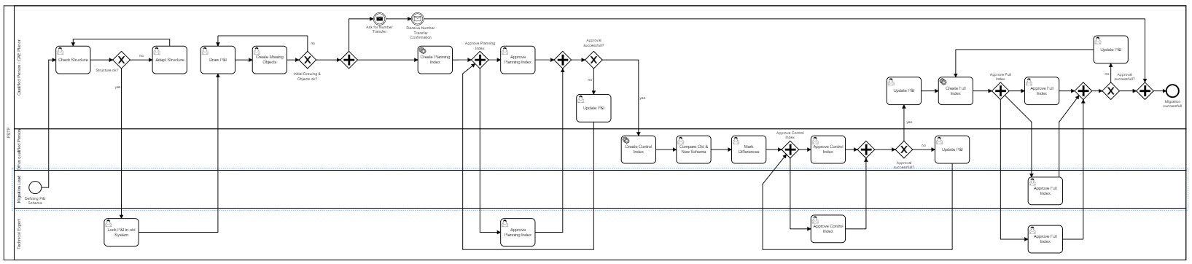
As Is Process
Only manual user tasks
No automation

Slide 5
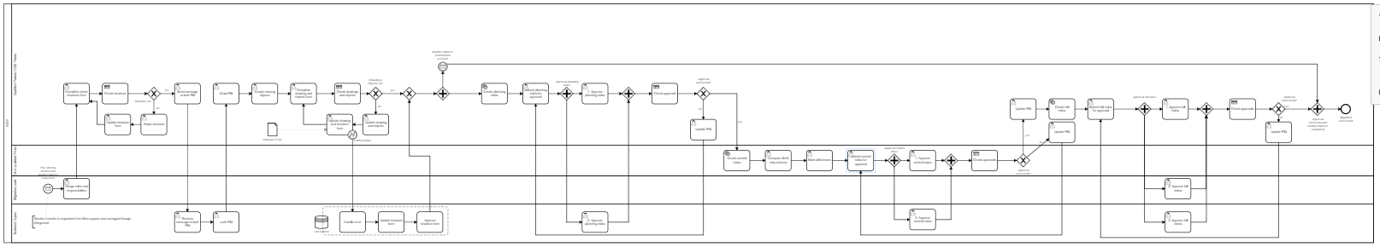
To Be Process
User assignment to tasks
Automated Business Process Rules for decision making
Automated cross functional communication through Integromat

Slide 6
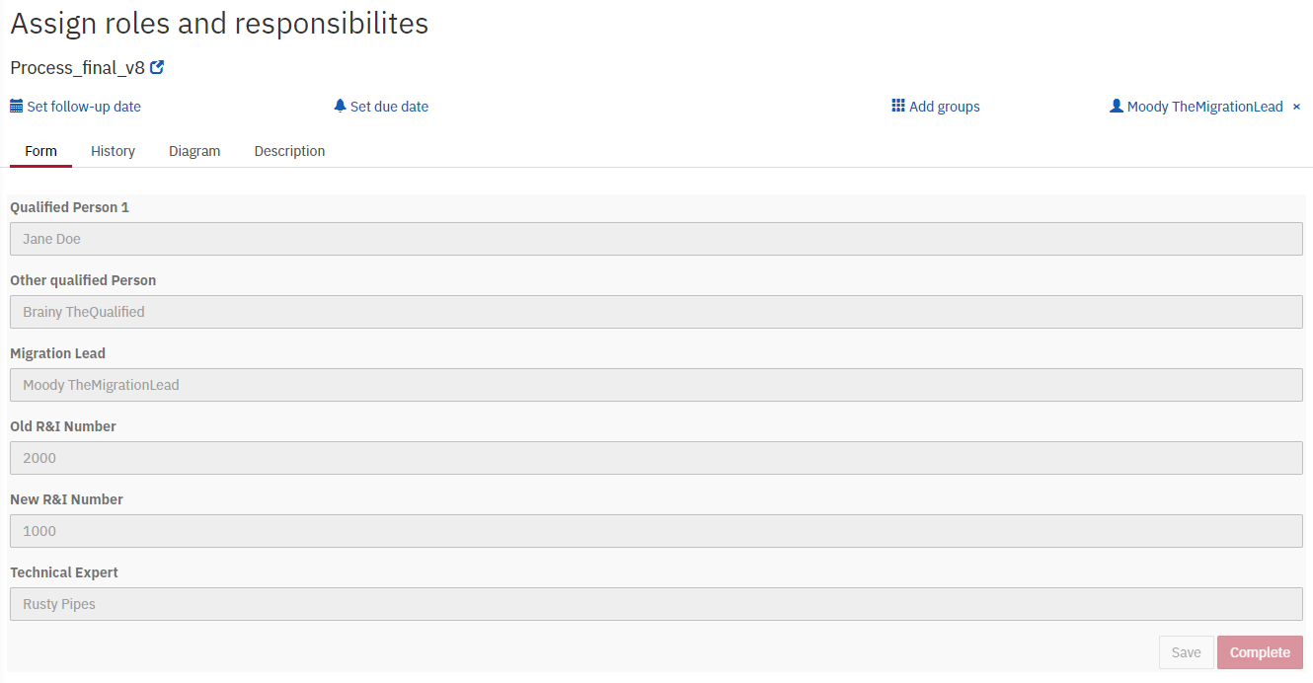
User assignment
Mockup

Slide 7
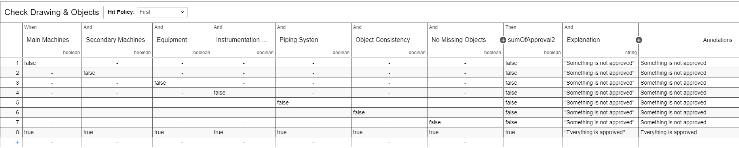
Automated Business Process Rules

Slide 8
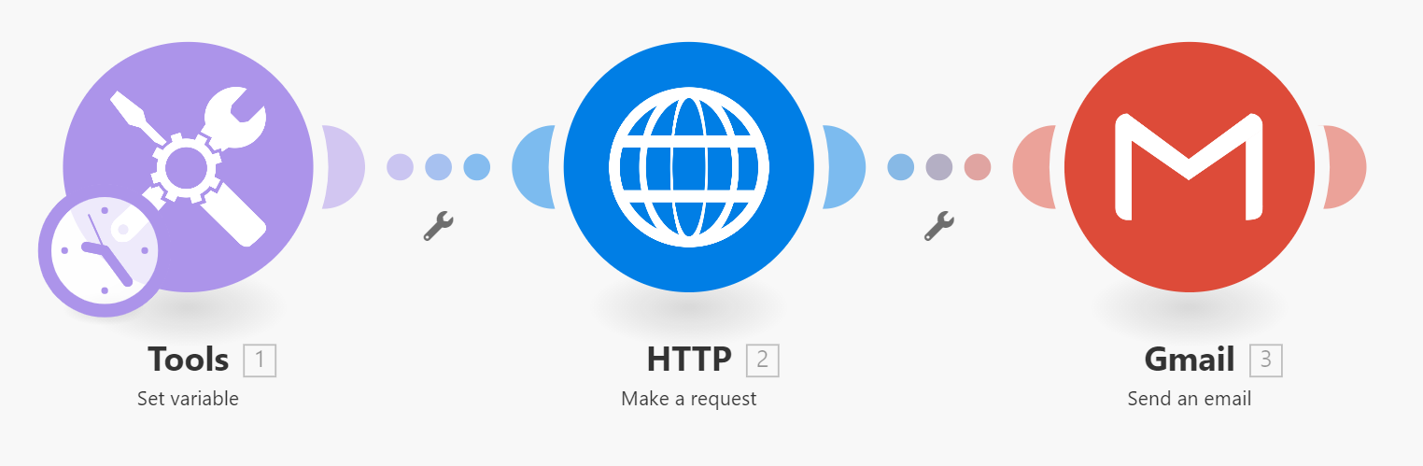
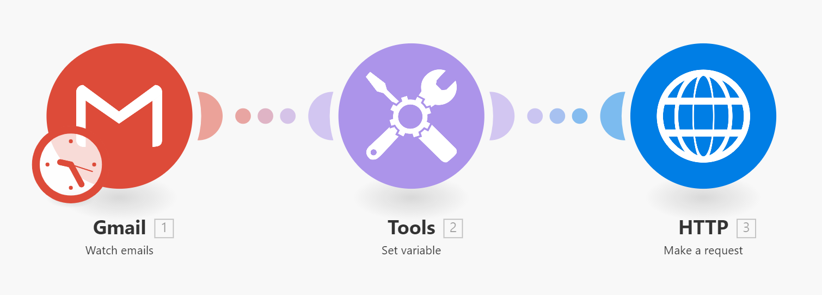
Automated cross functional communication

Slide 9
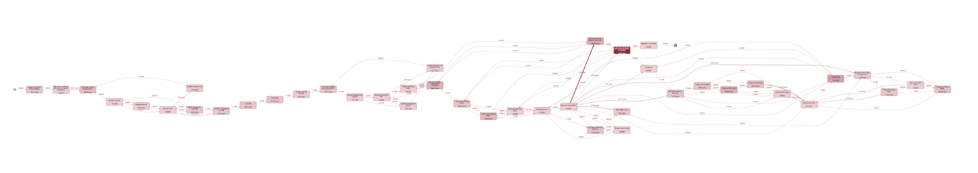
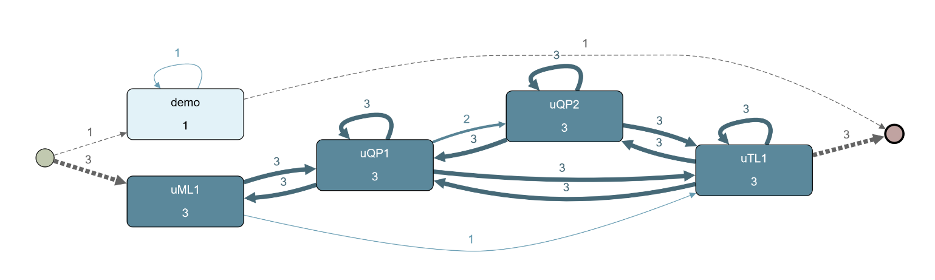
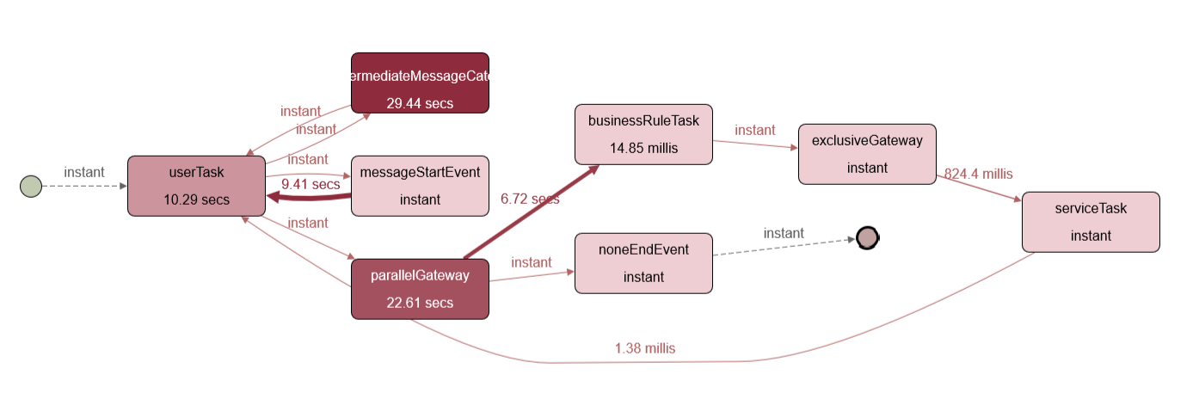
Process Mining with Apromore
Identifying bottlenecks and improvement opportunities

Slide 10
Benefits
Digitalization
Automation
Visibility
Traceability

Slide 11
Final remarks
Because of confidentiality:
No connection to production system
No real business logs
Simplified business logic

